Slide 1
Agentic RAG Chatbot for Multi-Format Document QA
Modular architecture using Openai, FAISS, Streamlit, and REST-style MCP messaging
KUNA LEELA KRISHNA – kleelakrishna753@gmail.com(9705359075)

Slide 2
Agent-Based Architecture with MCP
Agent Roles:
IngestionAgent: Preprocesses uploaded PDFs/DOCX/TXT and chunks text
RetrievalAgent: Embeds chunks via OpenAI + retrieves top matches via FAISSLLM
ResponseAgent: Queries OpenAI Chat API using retrieved context

Slide 3
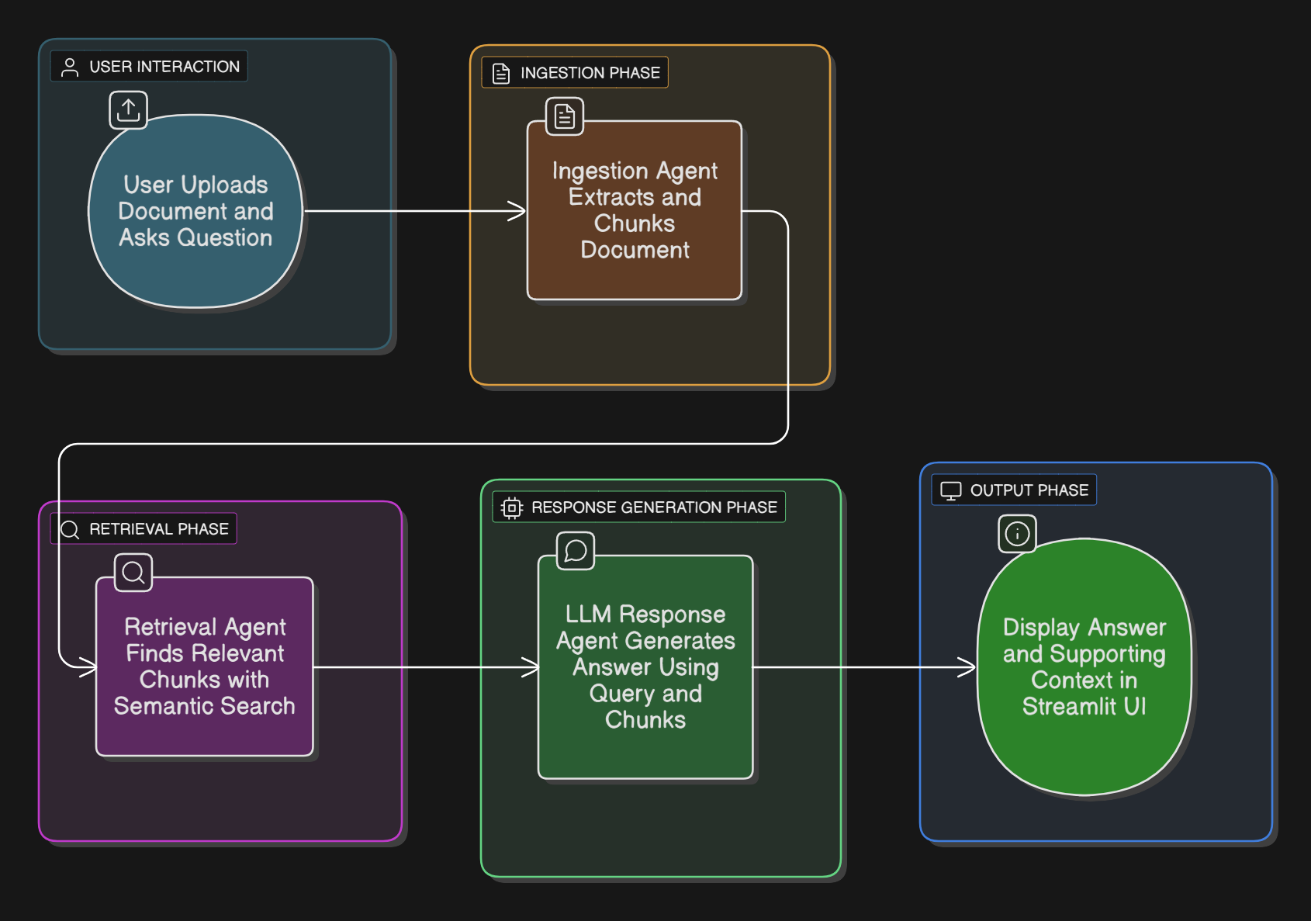
System Flow Diagram

Slide 4
MCP Message Example
{
"sender": "RetrievalAgent",
"receiver": "LLMResponseAgent",
"type": "CONTEXT_RESPONSE",
"trace_id": "abc-123",
"payload": {
"top_chunks": ["Chunk 1...", "Chunk 2..."],
"query": "What are the KPIs?"
}
}

Slide 5
Tech Stack Used
Component | Tool / Library
Vector DB | FAISS
Embeddings | OpenAI text-embedding-3-small
LLM API | OpenAI gpt-3.5-turbo
Parsing PDFs | PyMuPDF
DOCX Support | python-docx
Frontend UI | Streamlit
Message Passing | REST-style MCP Objects

Slide 6
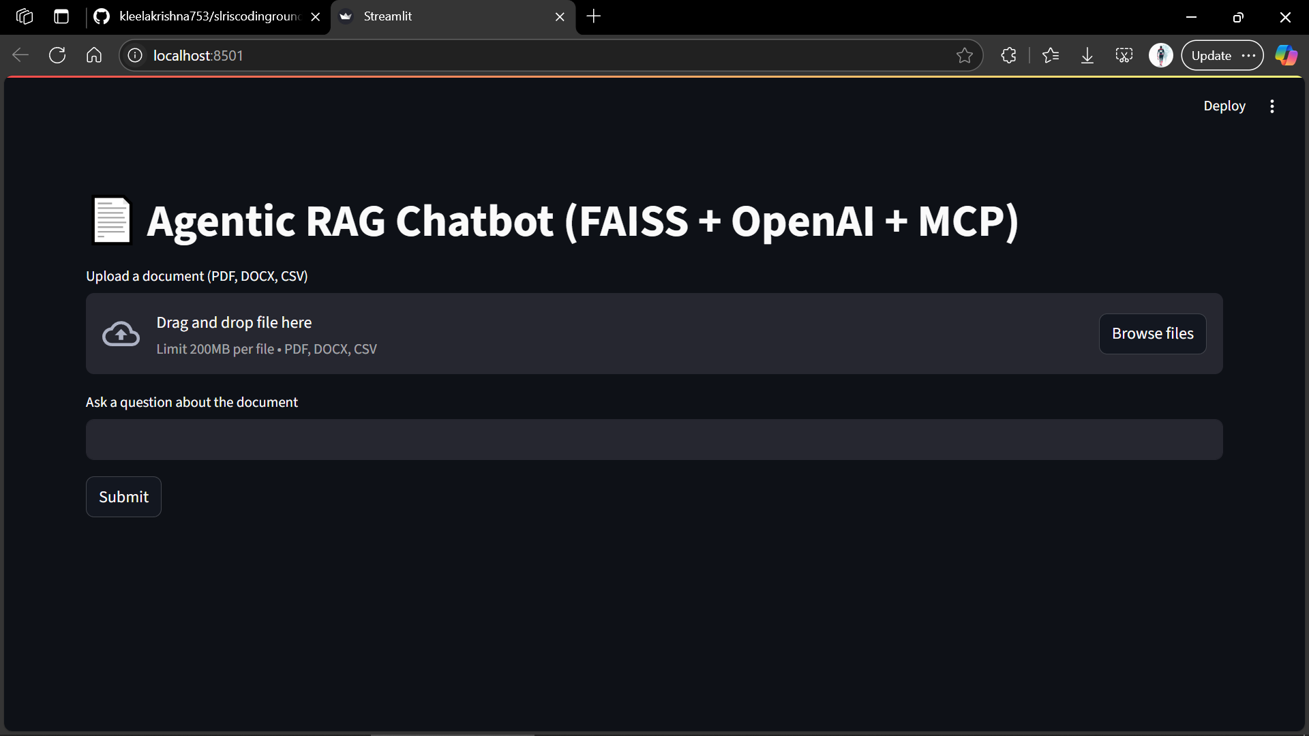
UI Screenshots

Slide 7
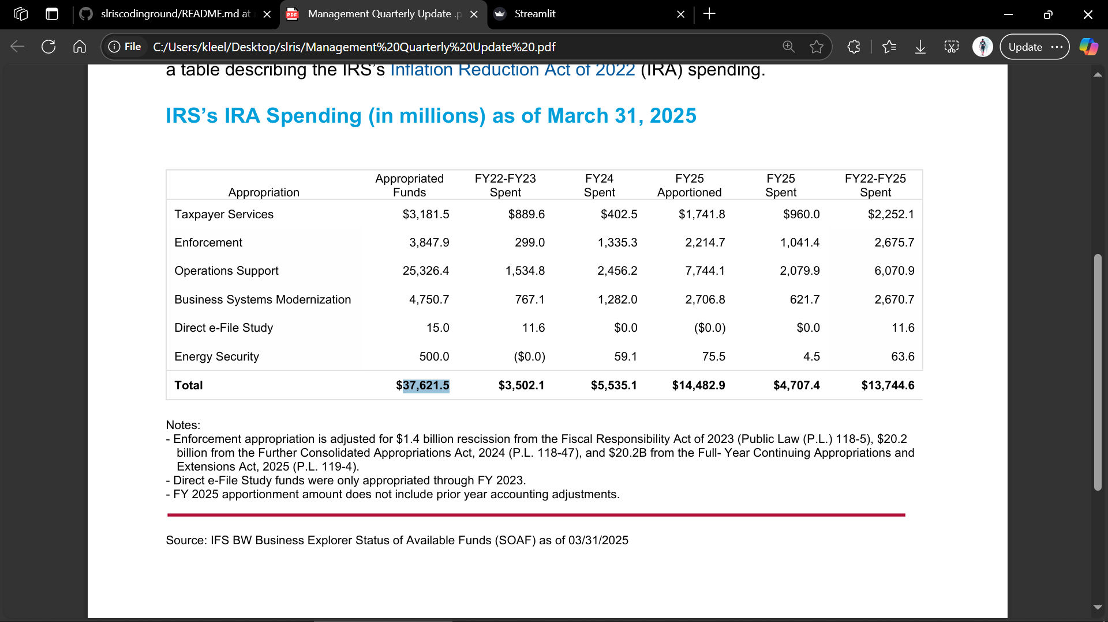
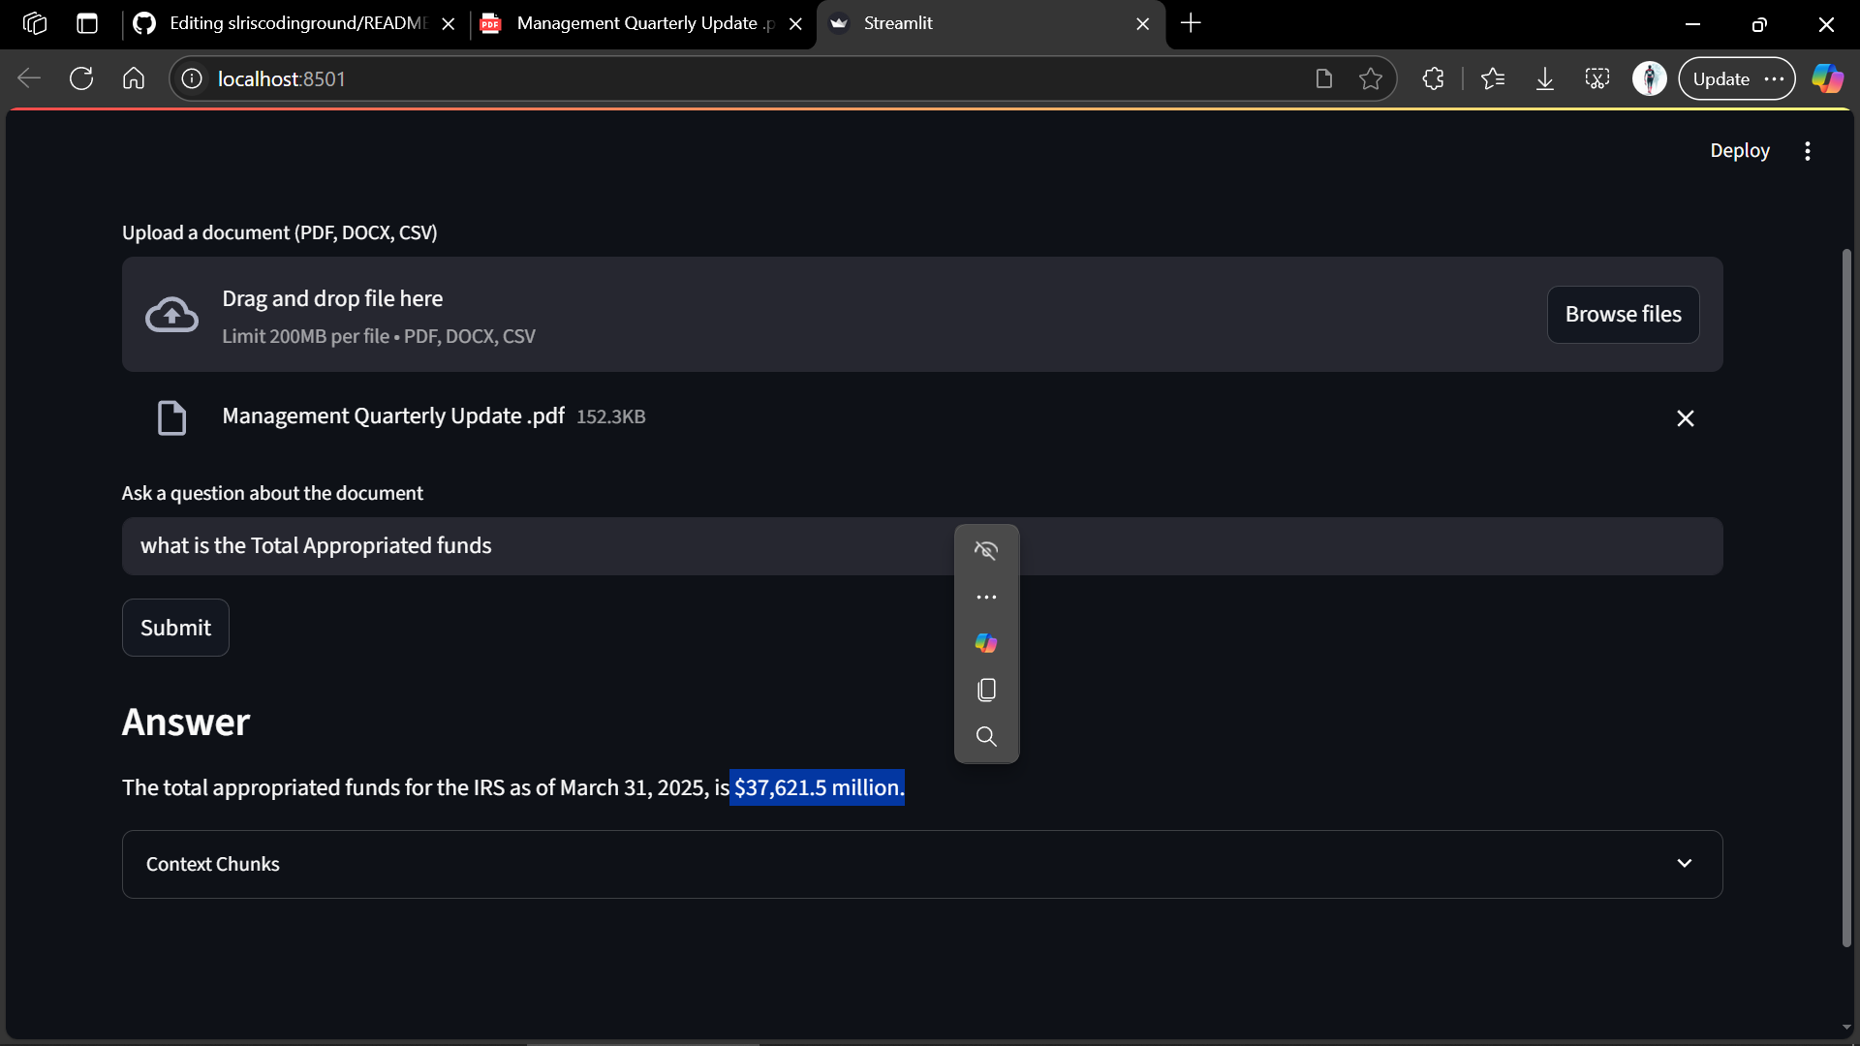
Working Example

Slide 8
Challenges
Parsing multi-format documents robustly
Designing structured MCP messages with proper routing
Handling async state in Streamlit with multiple agents

